Slide 1
CIS controls
By: Matthew Lattin

Slide 2

Chosen Controls
Control 3 Data Protection
Control 6 Access Control Management
Control 11 Data Recovery

Slide 3

Data Protection
Data is needed for a business to function
Proprietary information should remain private
Lack of protection can cause a lack of trust

Slide 4
Effective Data Protection
Define and classify data
Follow regulations
Most vital data needs strongest protections

Slide 5

Data Protection Implementations
Regular backups
Strong passwords
Multifactor authentication
Antivirus/antimalware
Encryption
Logging

Slide 6
Data Protection Implementations
Limit data access
Proper disposal
Firewall/ACLs
IDS/IPS
Segment data processing

Slide 7
Data Encryption
Protects data on mobile devices and removable media
Log access to sensitive data
Limit users who can access the data

Slide 8
Measuring Implementation
Amount of successful breaches
Number of times employees go against policies
Amount of data that needs to be protected
Number of alerts that are real vs false

Slide 9
Importance of Data Protection
Data stolen could be used by competitors
Data of employees could be compromised
Regulations need to be followed
Maintaining trust

Slide 10
Access Control Management
Confidentiality
Integrity
Track changes to data
Limit who can access resources and data

Slide 11
Implementing Access Control
Role based access control
Multifactor authentication
Process to remove or add access
Securing user accounts
Limiting what external facing servers can do

Slide 12
Implementing Access Control
Track what is public facing and what is not
Use multifactor authentication in remote access solutions
Limit use of administrative accounts

Slide 13
Measuring Effectiveness of Access Control
Number of administrative accounts
Amount of data and what data is accessed by users
How many failed login attempts an account has

Slide 14
Importance of Access Control
Need to maintain confidentiality by limiting who can access data
Need to track who accesses data in case there is an incident
Need to ensure that integrity remains
Managing access control also helps protect data

Slide 15

Data Recovery
Recovery process
Regular backups that happen at least daily
Offline copies of backups

Slide 16

Data Backups
Automate to ensure they always happen at scheduled times
Should backup outside of normal operational hours to limit disruptions that could be caused by data
Keep a copy offsite in case of disaster
Keep copy offline so it doesn’t have the same threats that operational data has
Test backups

Slide 17

Data Backups
Backups need protection just like main data does
Controls include encryption, offline backups, backups on different OS so it doesn’t have the same vulnerabilities
Make backups immutable so they can’t be destroyed

Slide 18
Measuring Data Recovery
Mean time to recover
Mean time between failures
Percentage of data successfully recovered
RPO and RTO

Slide 19
Importance of Data Recovery
Data is valuable so data loss needs to be limited
Managing backups important to ensure they are safe and usable

Slide 20

Implementing Access Control Management
Role based access control
Multi-factor authentication
Centralized manager
Onboarding and offboarding procedures and policies

Slide 21

Implementation
Used Windows AD to create users and groups
Created folders and shared those with the correct groups
Creating groups allowed for role based access control
Create accounts as needed and disable accounts that are no longer needed

Slide 22
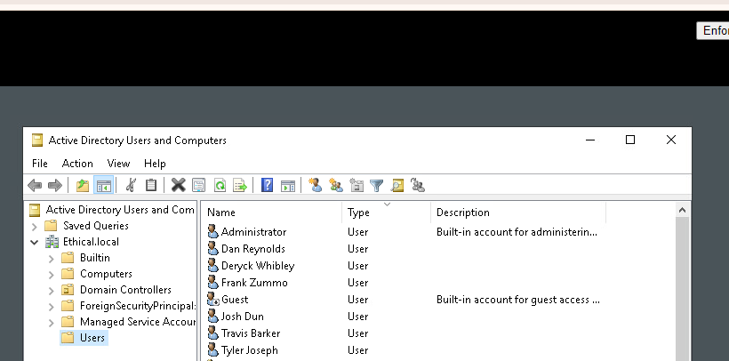
Users created
Added 6 users and 2 groups

Slide 23
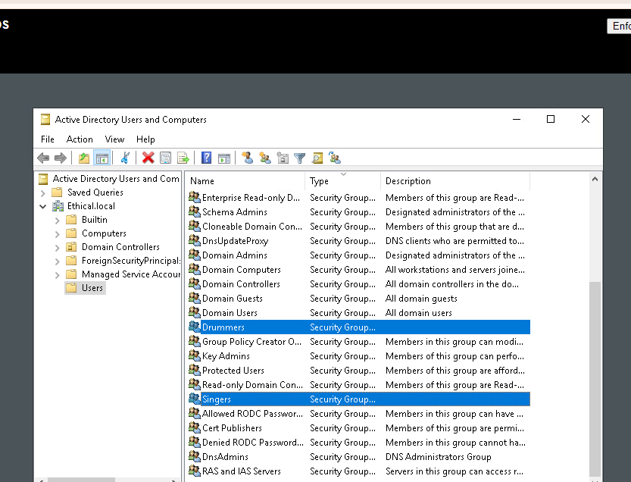
Groups Created

Slide 24
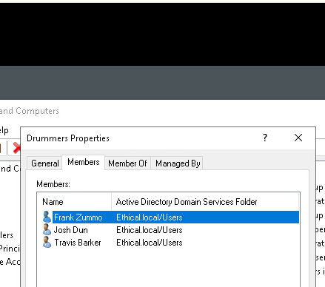
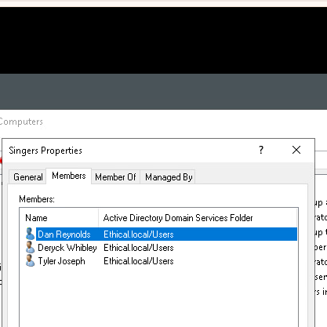
Groups

Slide 25
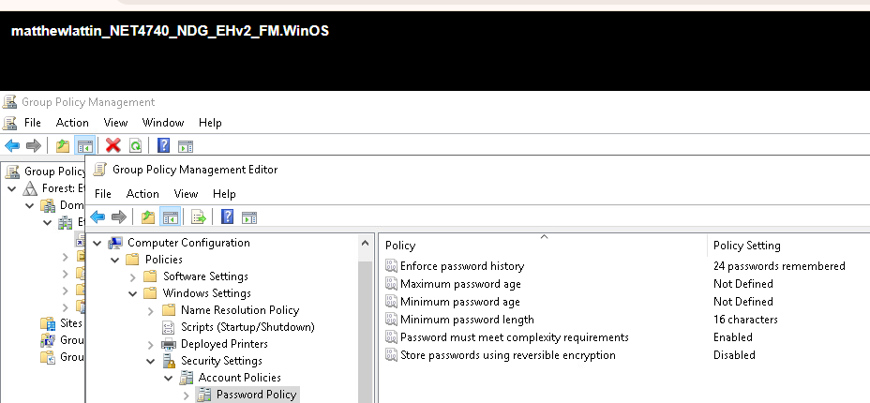
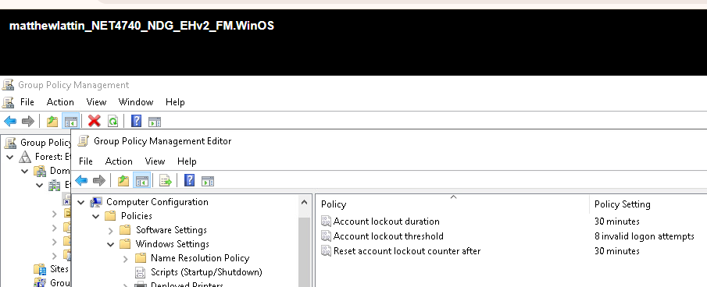
Password Policy
Require 16 character passwords to limit brute forcing account passwords
Limited to 8 failed login attempts before account locks

Slide 26
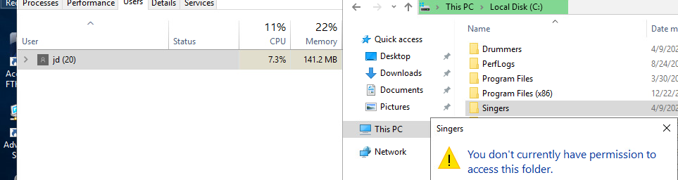
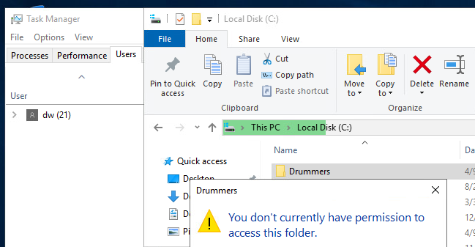
Shared Folders

Slide 27
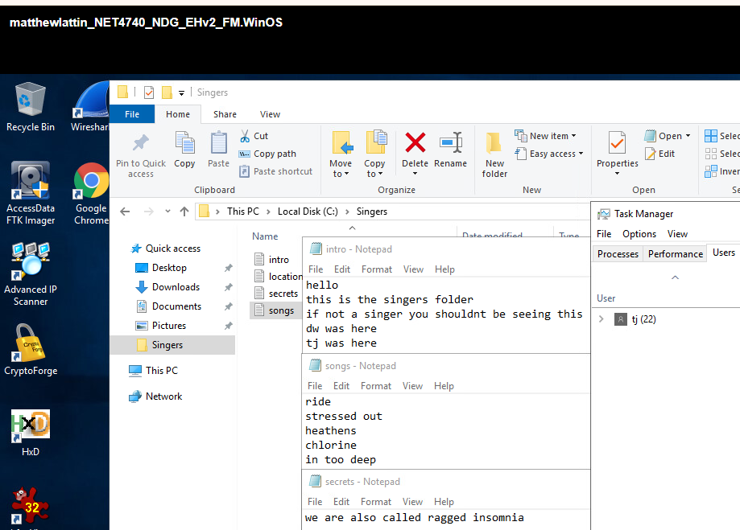
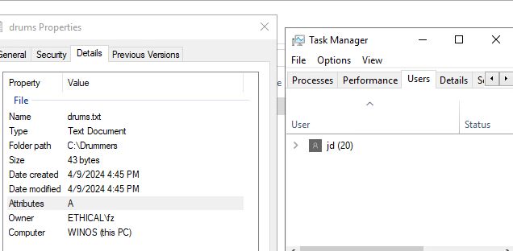
Shared Folders

Slide 28
Final Implementation
Successfully implemented role-based access control, central management of control, ways to onboard and offboard users
Multifactor authentication not implemented but could be implemented by using a smartcard, or biometrics for example.

